Slide 1
Prime-MFR Geospatial Expansion
Nathan Lim

Slide 2

Presentation Roadmap
Overview of model changes
Walk through the features that improved the model
Discuss the features that did not help
Next steps

Slide 3
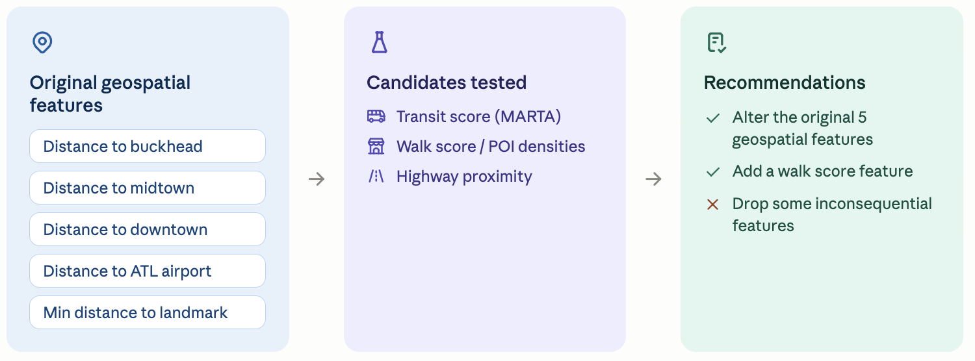
Overall MAE Decreased by 3.59%
Original Geospatial Features:
Distance to buckhead
Distance to midtown
Distance to downtown
Distance to atl airport
Min distance to landmark
Candidates for Feature Engineering:
Transit Score (MARTA)
Walk Score/POI Densities
Highway Proximity
Model Recommendations:
Alter the original 5 geospatial features
Add a Walk Score Feature
Some inconsequential features

Slide 4
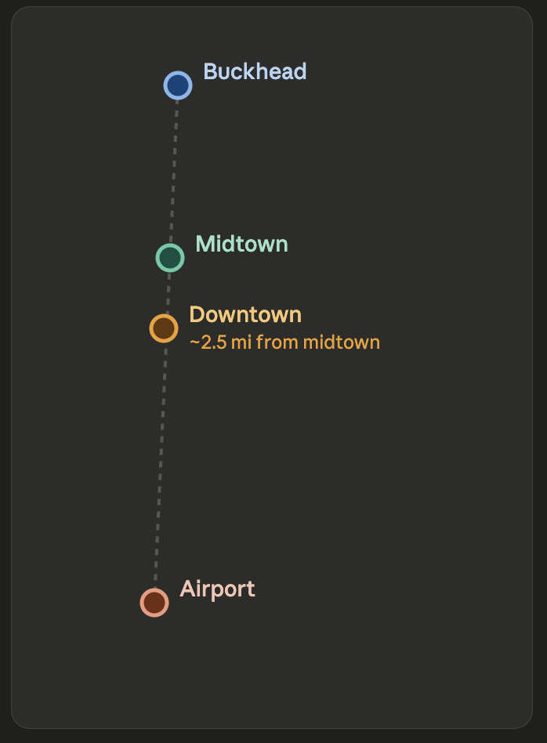
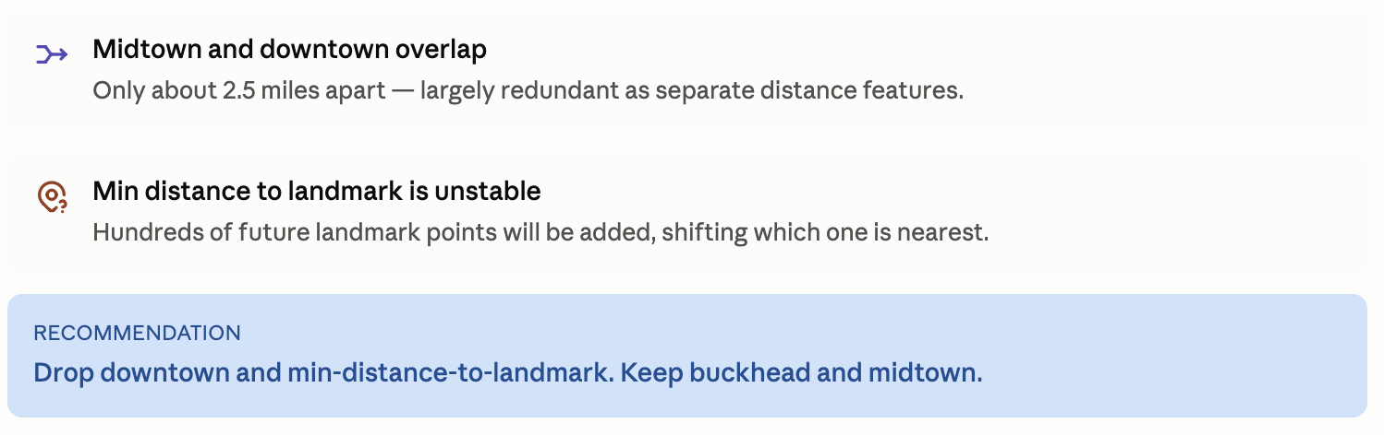
Dropping the “Downtown” and “Min Landmark” Features Improved Accuracy by 1.28%
Map of Current Landmarks
Distance to Midtown/Downtown: Largely Redundant
Midtown and Downtown are only ~ 2.5 miles apart
Min Distance to Landmark:
Hundreds of future landmark points will be added

Slide 5
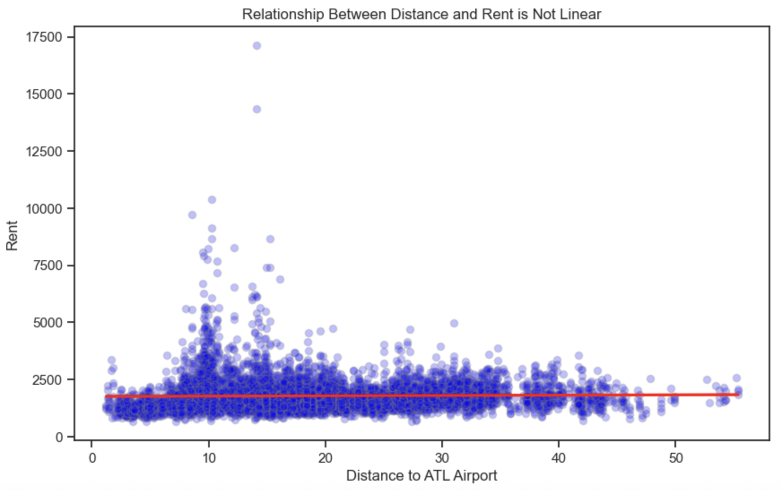
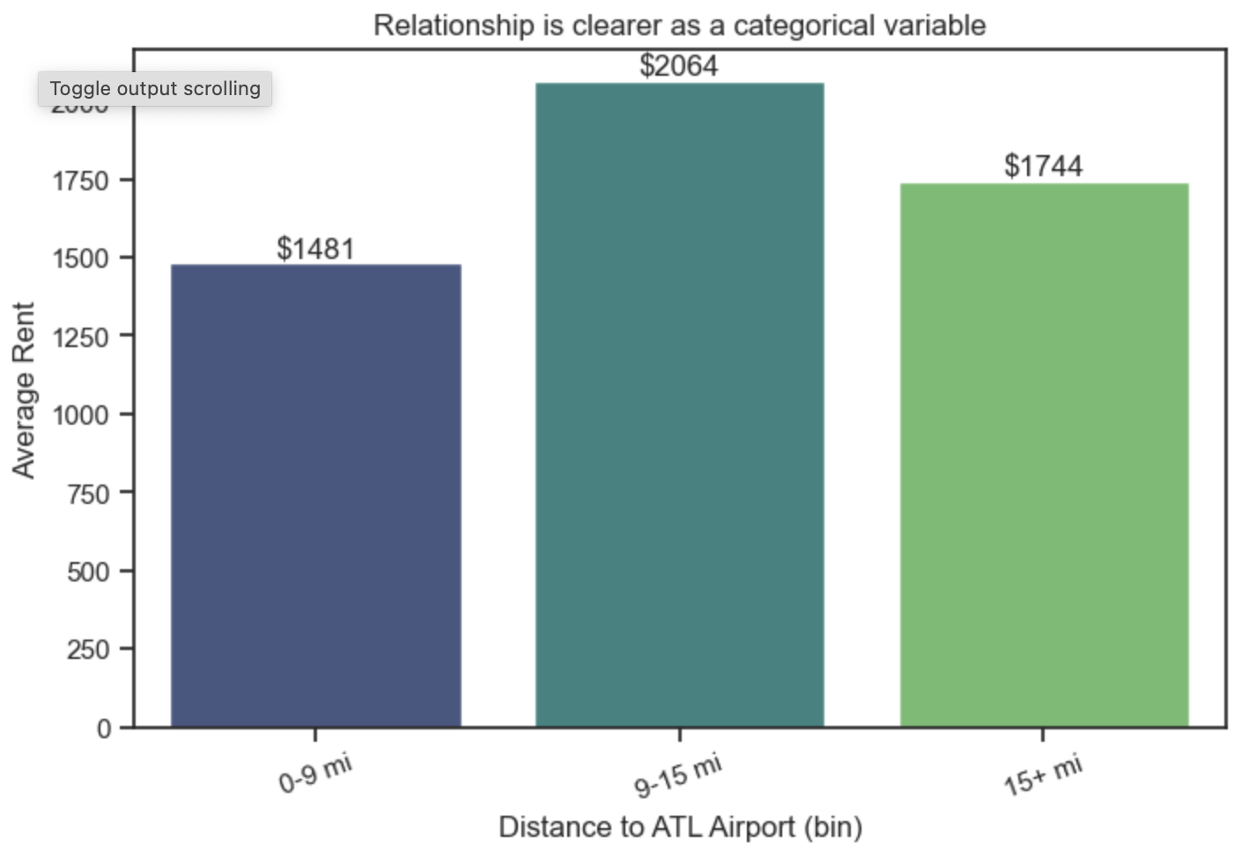
Changing Airport Feature to Categorical Reduced MAE by 1.20%
Not a strong linear correlation, but there is a clear sweet spot below which and above which distance doesn't necessarily help rent.

Slide 6
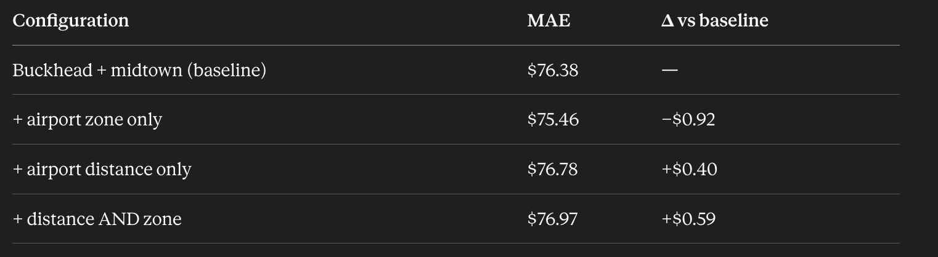
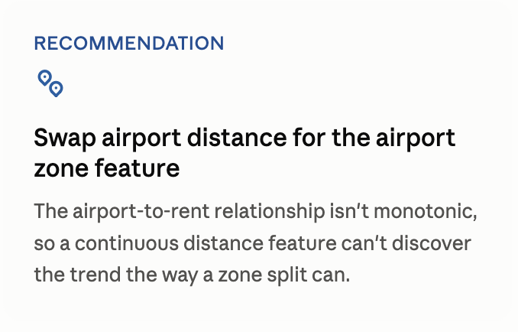
Changing Airport Feature to Categorical Reduced MAE by 1.20%
Recommendation: Add “airport zone” feature Airport to rent relationship isn’t monotonic, which makes it hard for a continuous “dist_atl_airport” feature to discover the trends
Airport Distance feature: distance from property to the ATL airport Airport Zone feature: divides distances into three categories: “near” (0-9 mi), “hot-zone” (9-15 mi), and “far” (15 mi+)

Slide 7
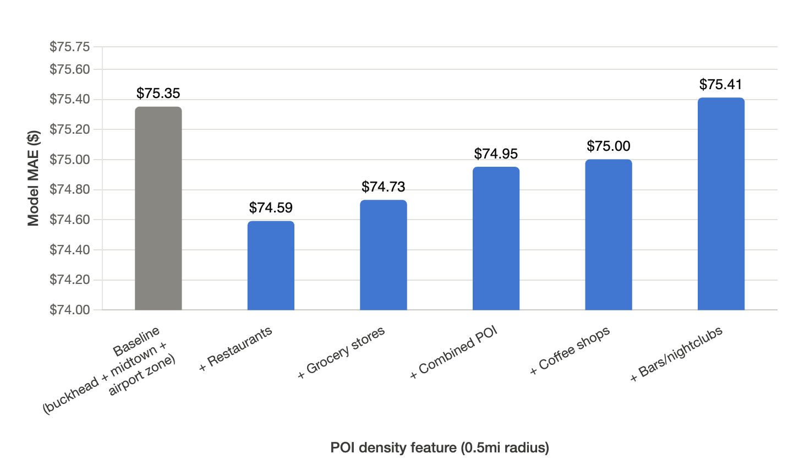
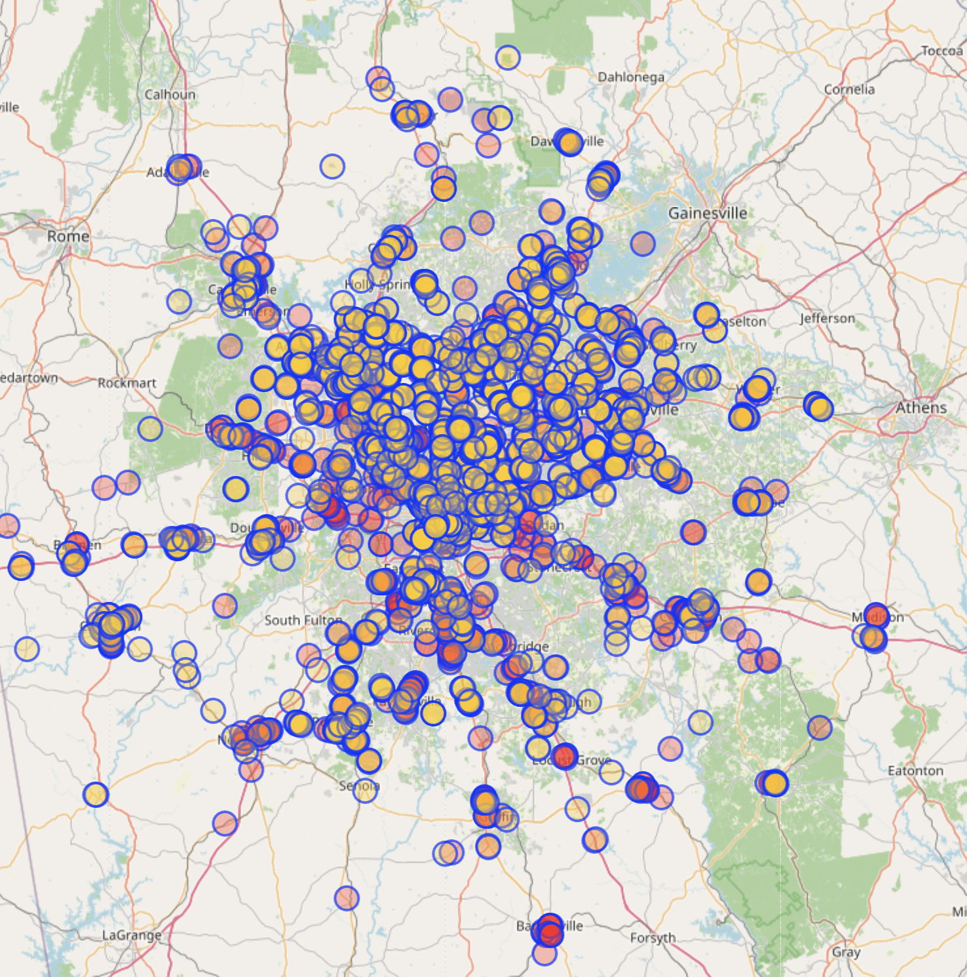
Walk Score Feature Decreased MAE by 1.01%
4813 POI’s in Atlanta MSA
4,813 Points of Interest Tested: (Data queried from OpenStreetMap)
Coffee Shops (299)
Grocery Stores (680)
Restaurants (3638)
Bars/Nightclubs (196)
Rent premium for areas with “urban amenities” vs. POI-sparse areas
Recommendation: add “restaurants within 0.5 miles” feature
$75.35 -> 74.59 -1.01%

Slide 8
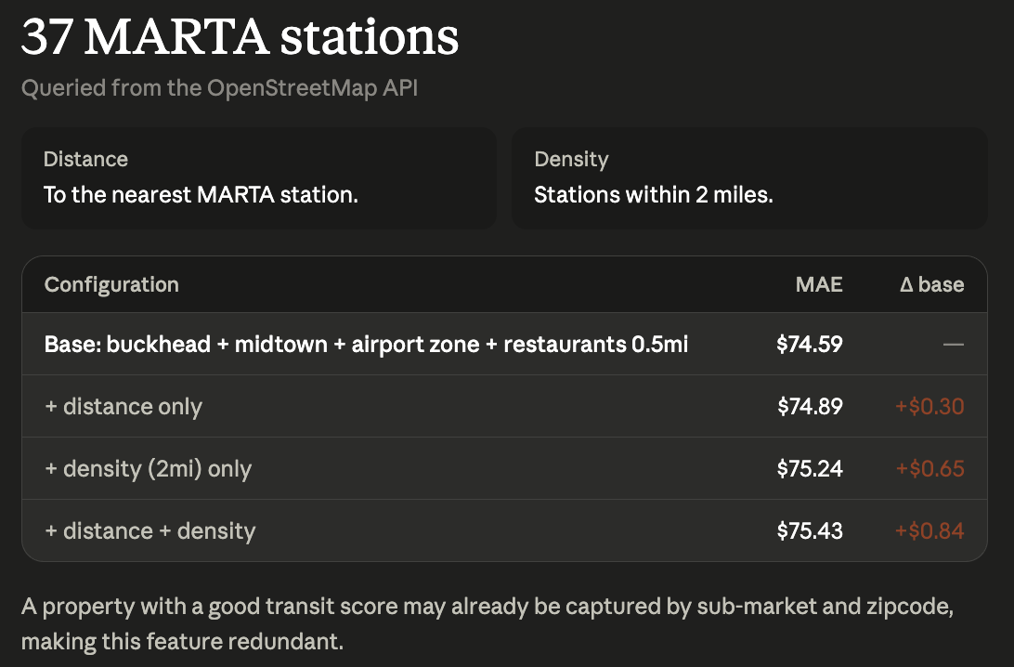
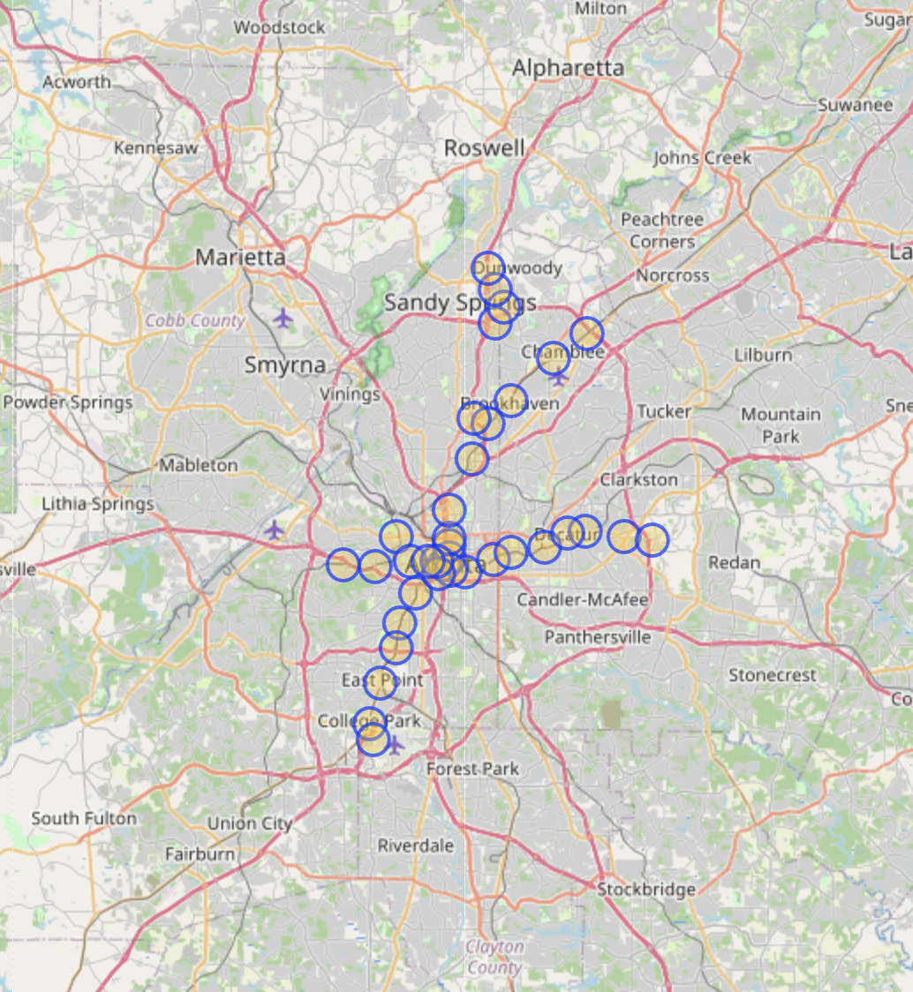
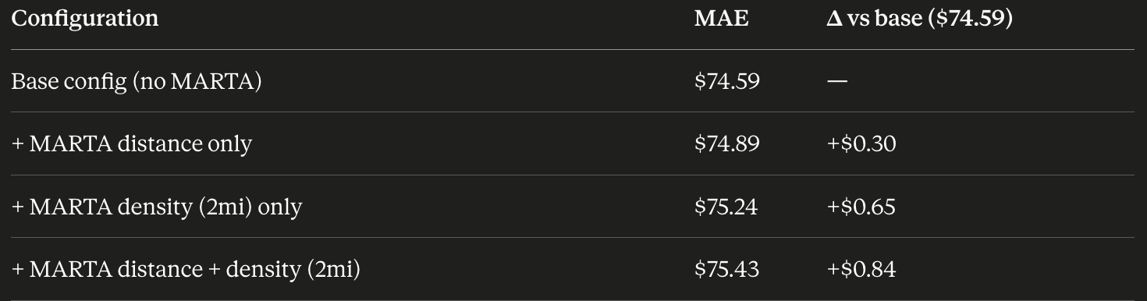
Features that Failed to Improve Accuracy: Transit Score
Map of MARTA Stations
Data source: queried data from OpenStreetMap API
37 unique MARTA stations
Features tested:
Distance: distance from property to the nearest MARTA station
Density: number of MARTA station within 1 mile
Explanation: Areas with good Transit Score might already be captured by other existing features (sub-market, zipcode, etc.), making this feature redundant

Slide 9
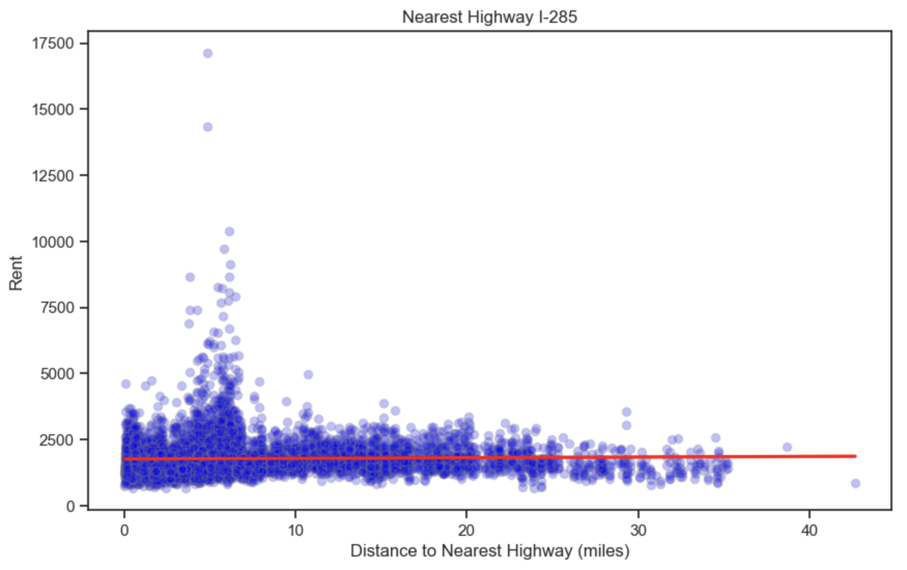
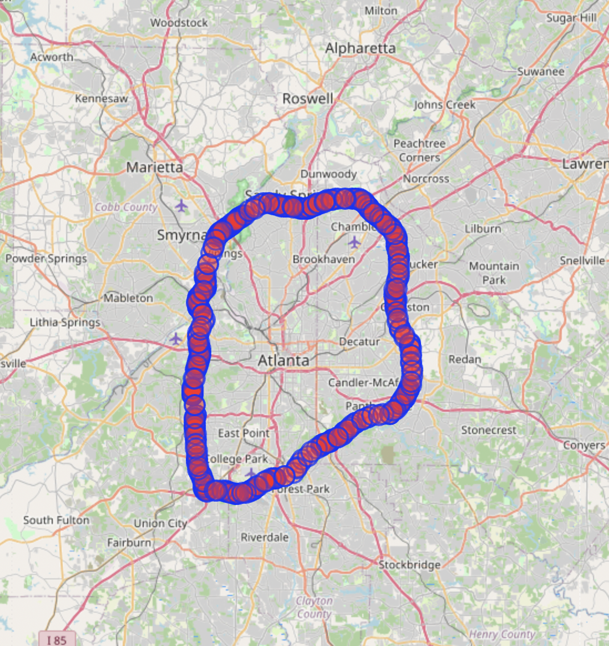
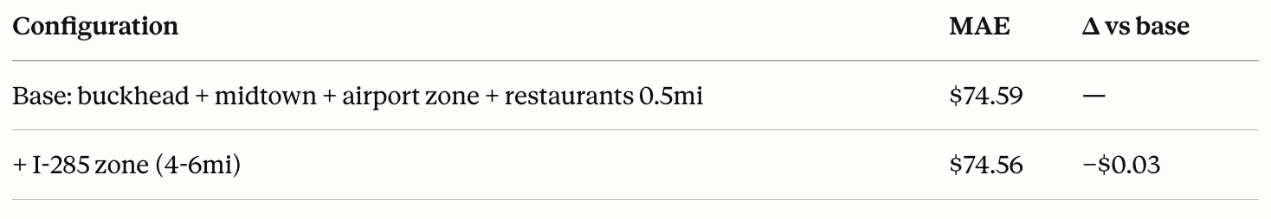
Features that Failed to Improve Accuracy:
Highway Proximity
I-285 Highway Points (every 0.25 km)
jfljdsfkdjflkjsdflksfjljd

Slide 10
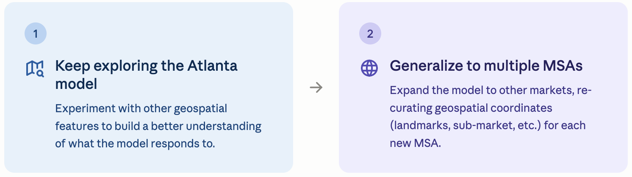
Next Steps
Continue to explore the Atlanta Model
Experiment with other geospatial features to get a better understanding of what the model likes
Multi-MSA generalization: Expand model to other MSA markets
Re-curate geospatial coordinates for the new MSA (landmarks, sub-market, etc.)

Slide 11
Thank You!

